Slide 1

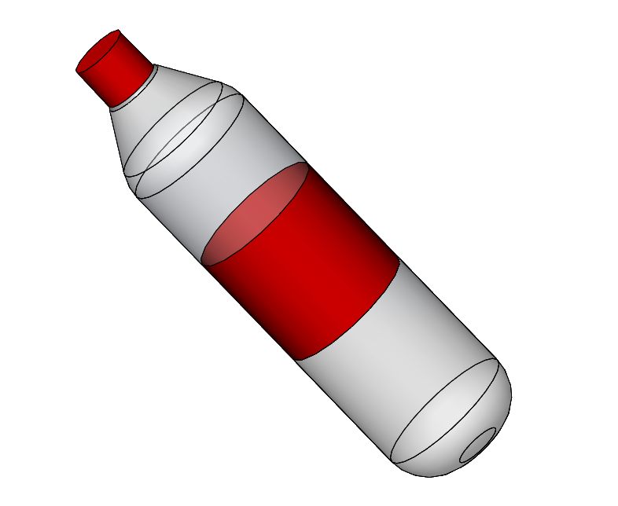
STI – robot competition
TEAM 3
Milestone number 3
Claudio Fritsche (GM)
Roman Oechslin (MT)
Héloïse Boross (MT)
20th March 2017

Slide 2
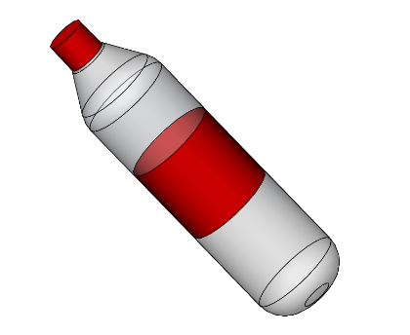
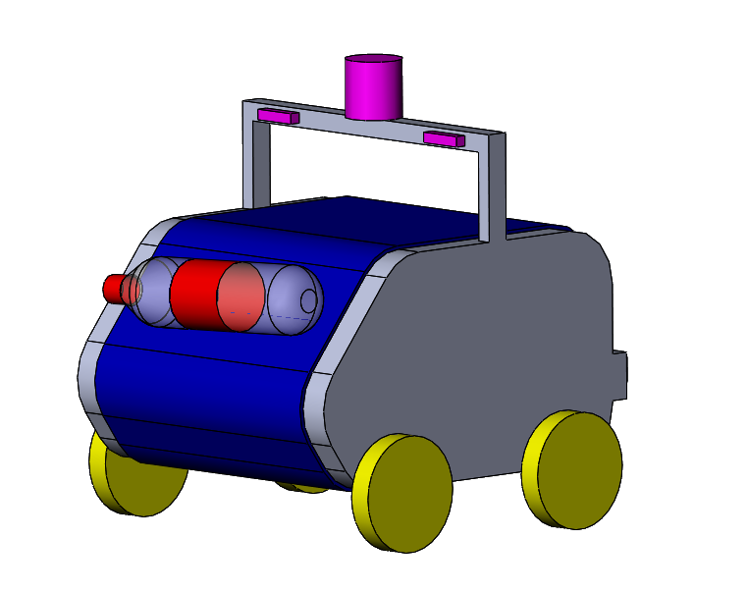
Concept
2
Introduction HW mechanics HW electronics Budget Software Management

Slide 3
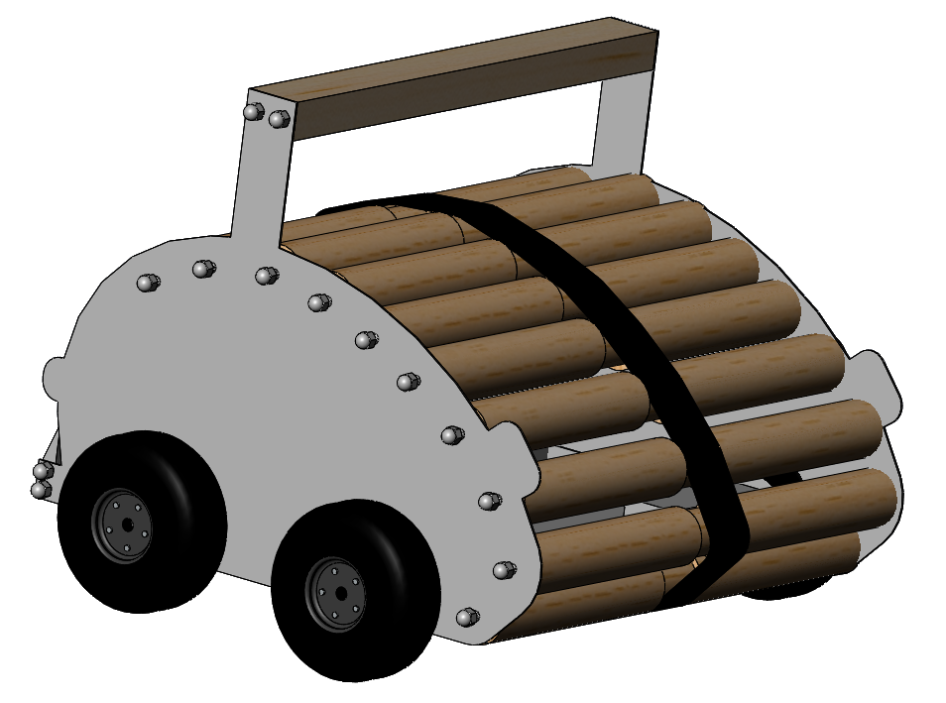
Pre-design
WEAKNESSES
No facylities to built wood pieces
Too many screw to remove to open the robot
Too many mechanical pieces
Round shape doesn’t maximize the surface’s contact between the conveyer belt and the bottle
The thin belt which drives the sticky one will slip on the rollers
3
Introduction HW mechanics HW electronics Budget Software Management

Slide 4
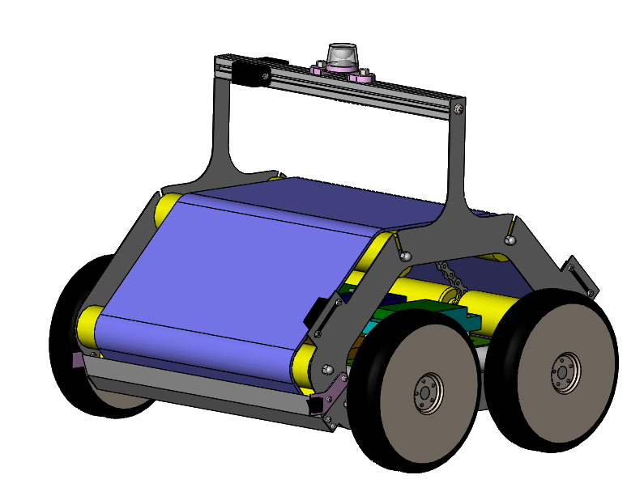
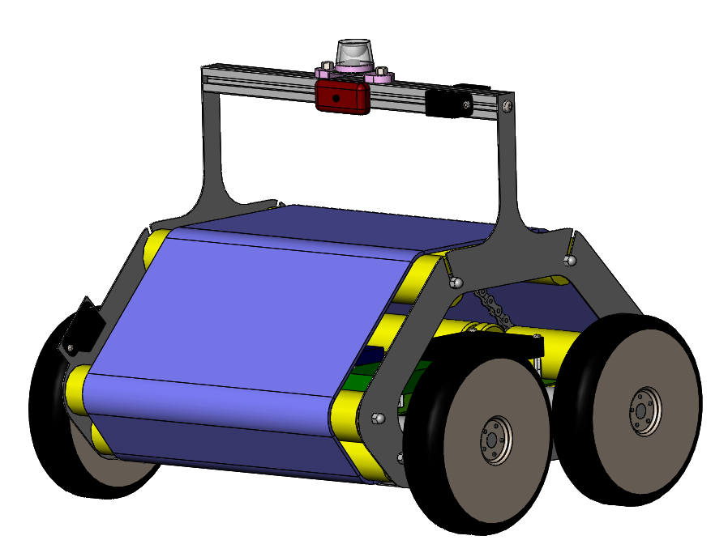
Outside of the robot
Camera
360° camera
4 x IR sensors
FRONT
Sticky conveyer belt
Bottle releaser
BACK
2x Bumpers
Aeration and access hole
4
Introduction HW mechanics HW electronics Budget Software Management
Notes:
Dimensions générale et explications générales

Slide 5
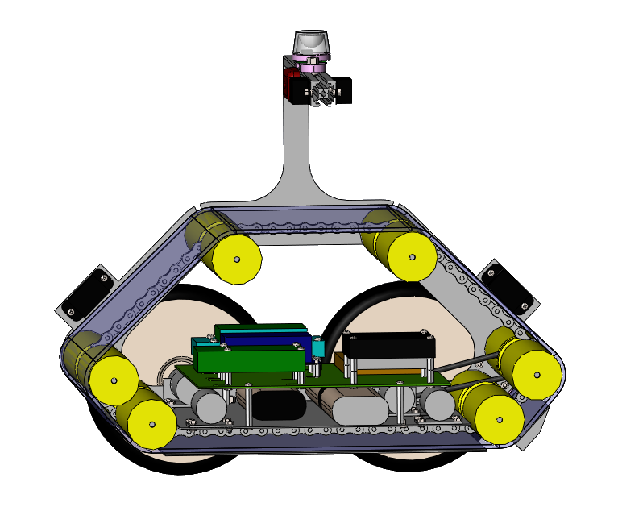
Inside of the robot
Roller
Electonics
5x Motors
3x Batteries
5
Introduction HW mechanics HW electronics Budget Software Management

Slide 6
Dimensions
97 mm
362 mm
250 mm
110 mm
300 mm
31 mm
38 mm
375 mm
419 mm
6
Introduction HW mechanics HW electronics Budget Software Management

Slide 7
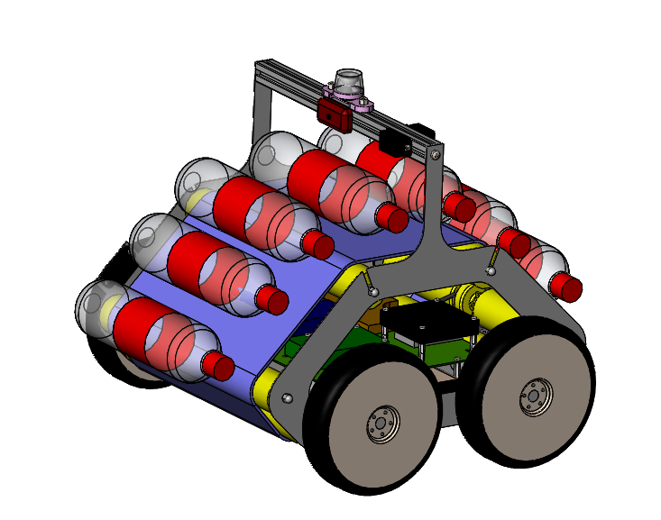
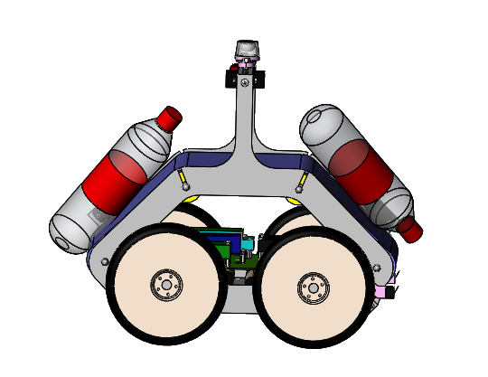
Expected capability
from 2 to 7 bottles
7
Introduction HW mechanics HW electronics Budget Software Management

Slide 8
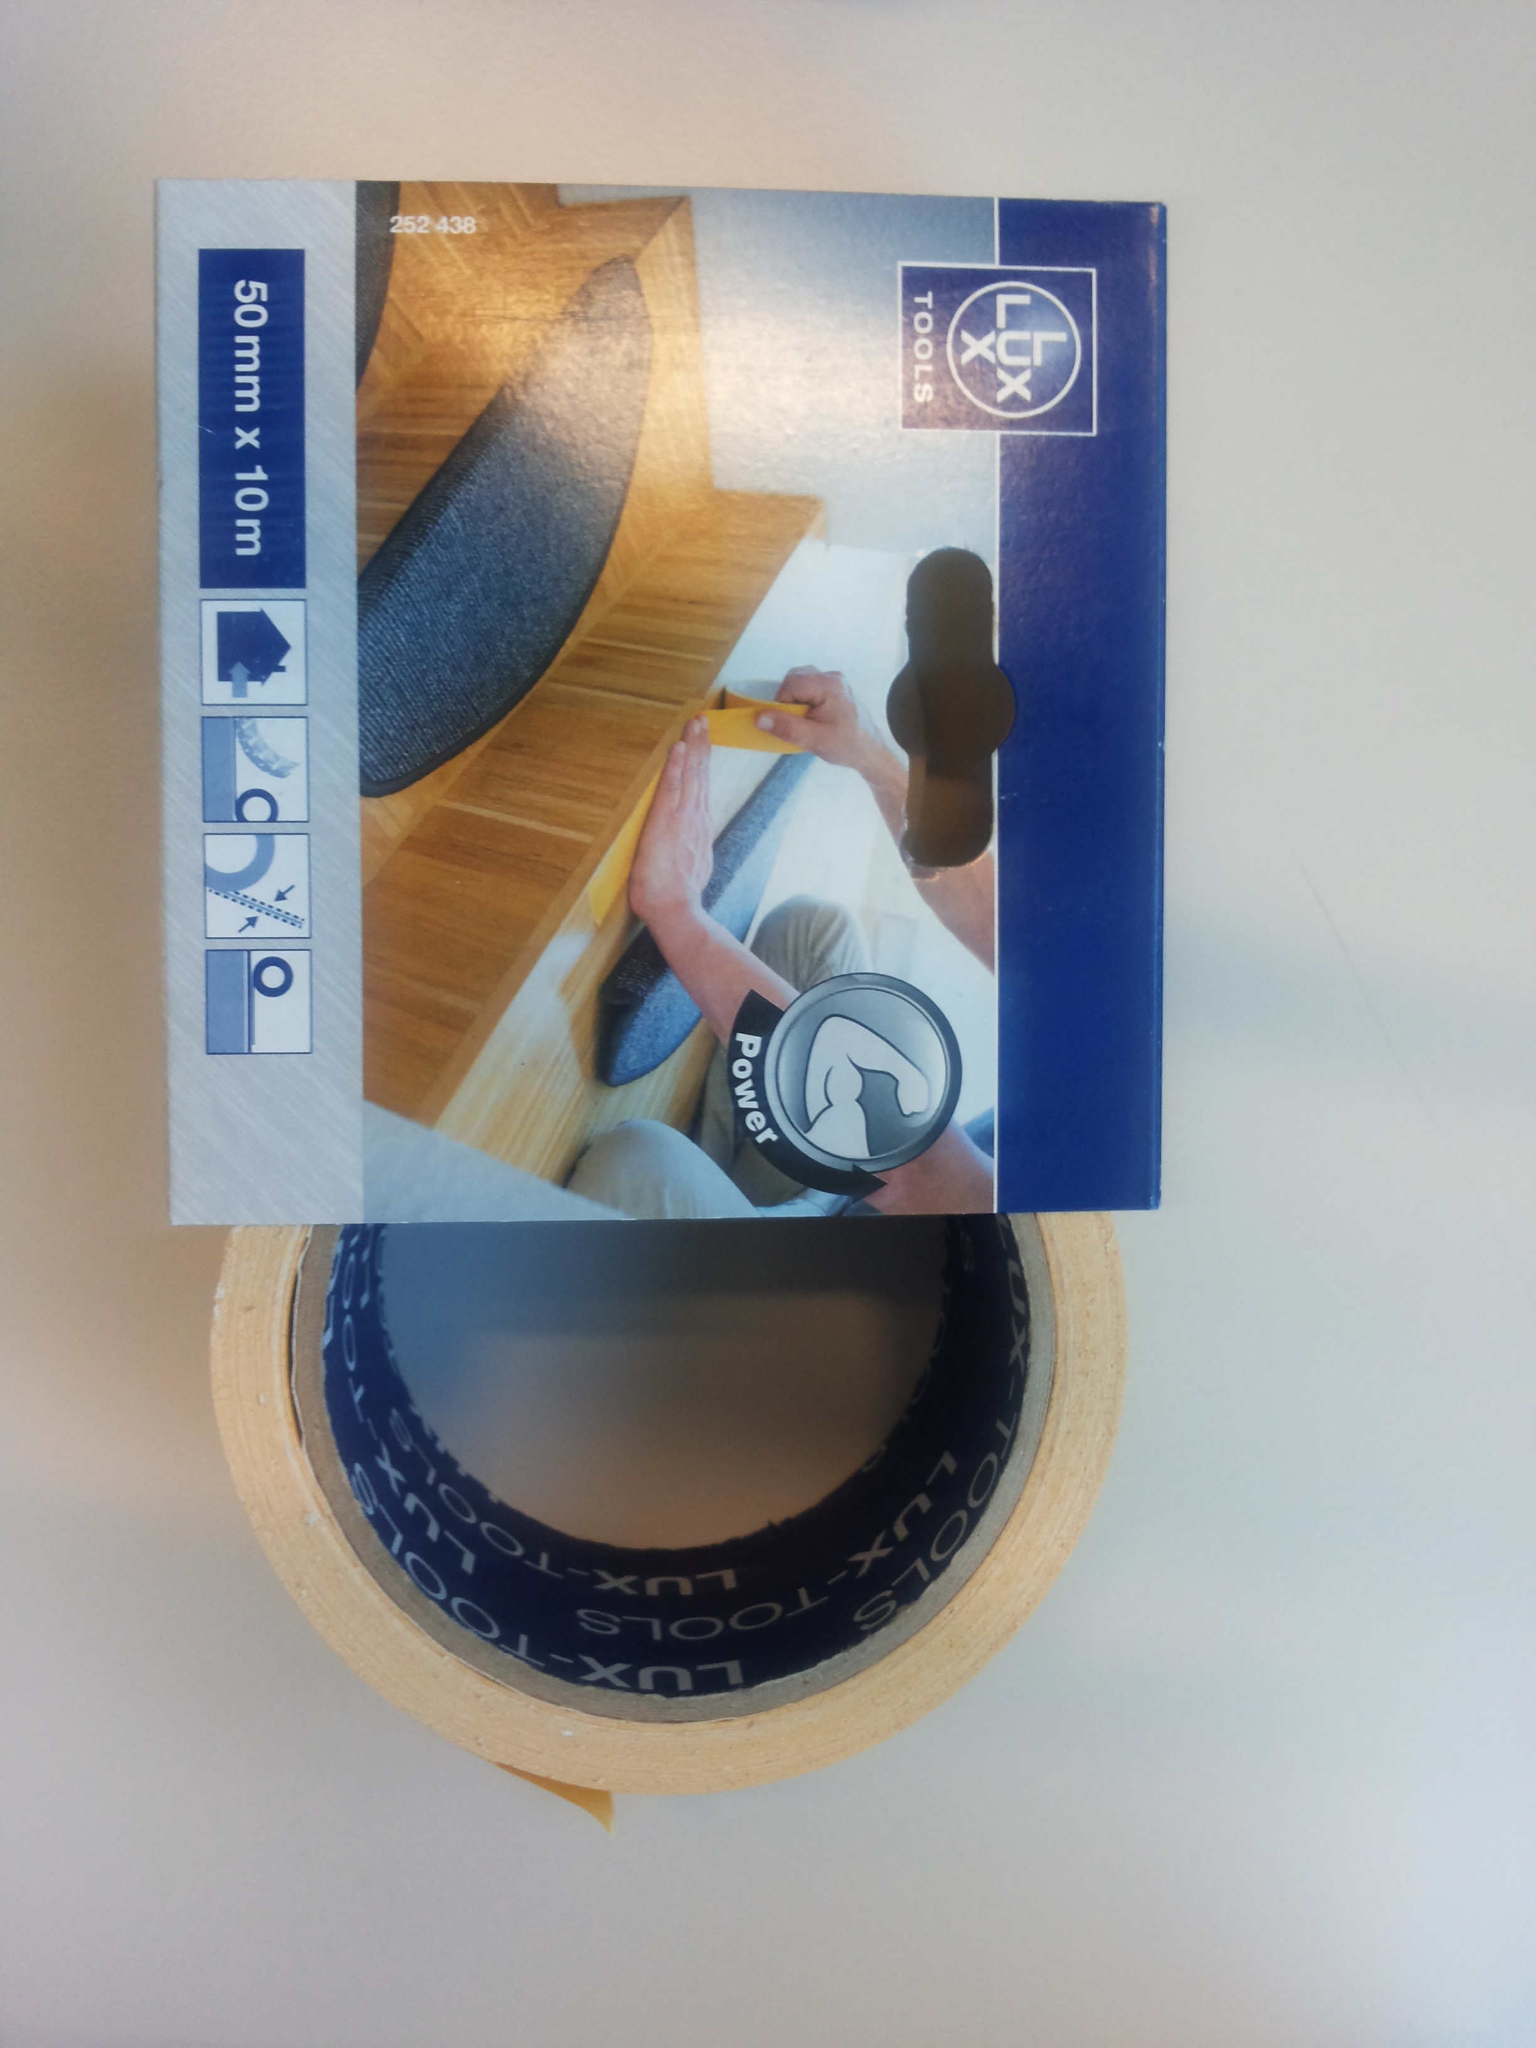
Sticky material
Two sided duct tape
Robust to vibration
Good repeatability
Robust to dust
Cheap solution
8
Introduction HW mechanics HW electronics Budget Software Management
How to fix it? (explain)
2-Faces tape

Slide 9
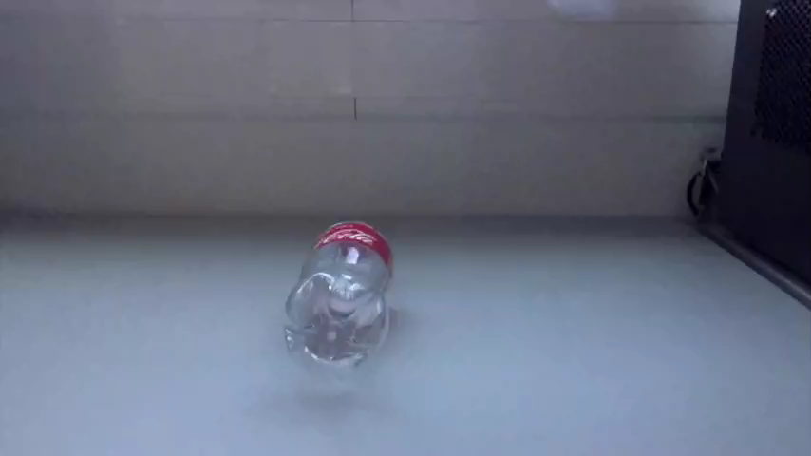
Sticky material testing
9
Introduction HW mechanics HW electronics Budget Software Management

Slide 10
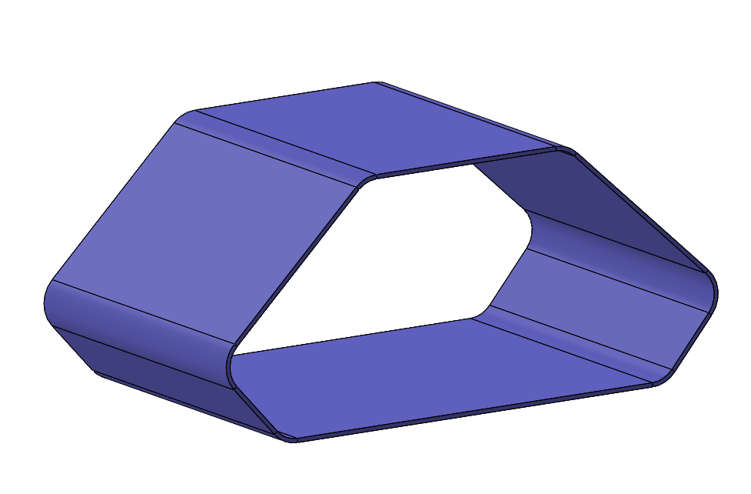
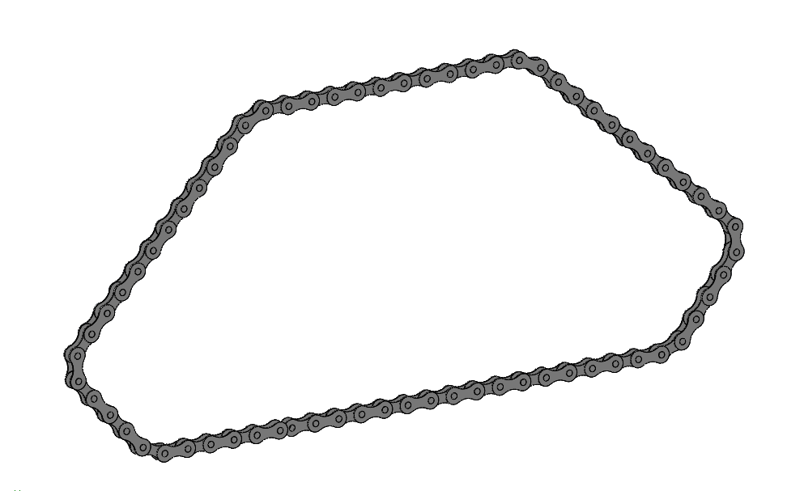
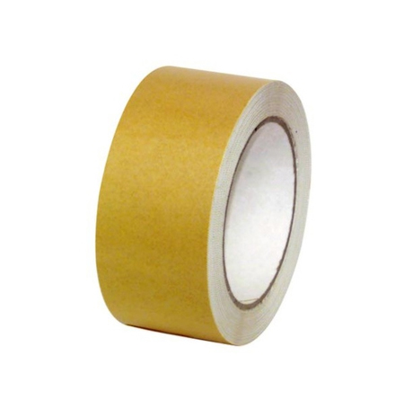
Sticky belt fabrication
Sewing
Taping
10
Introduction HW mechanics HW electronics Budget Software Management

Slide 11
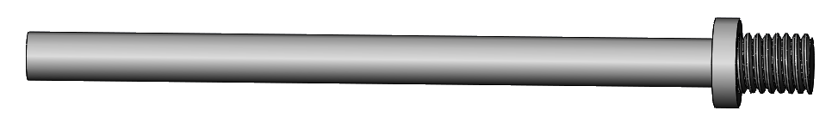
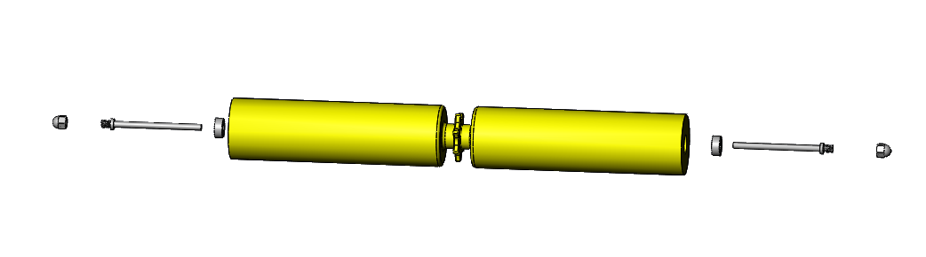

Roller
Axle
Ball bearing
FREE AXLE
Round-head nut
Sides of the robot
ACTUATED AXLE
11
Introduction HW mechanics HW electronics Budget Software Management

Slide 12
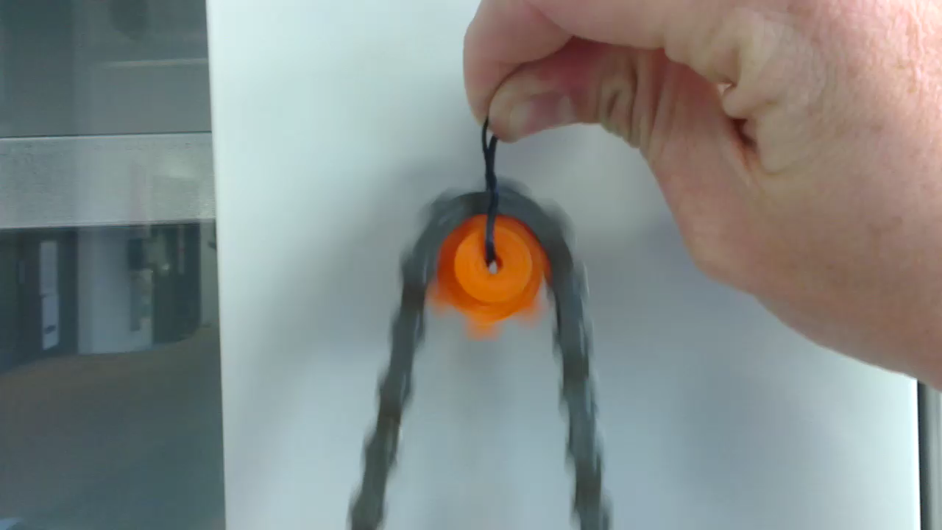
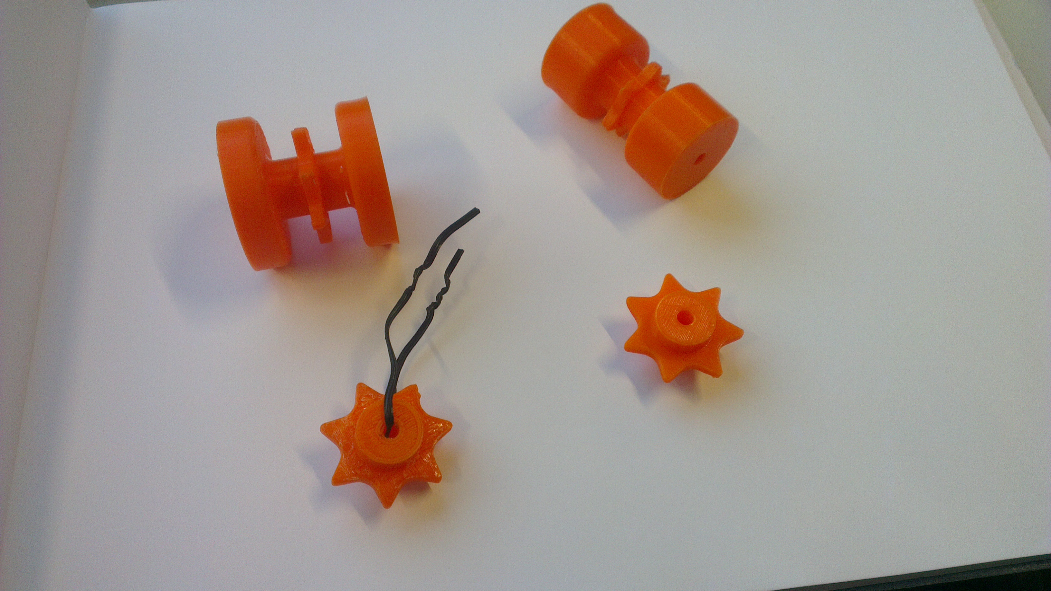
Sprocket testing
How is the conveyor belt driven?
Bycicle chain fixed to belt
Sprockets
DC – motor
12
Introduction HW mechanics HW electronics Budget Software Management
Focus sur les parties à expliquer plus en détail
Sprockets test
Navigation explanation

Slide 13
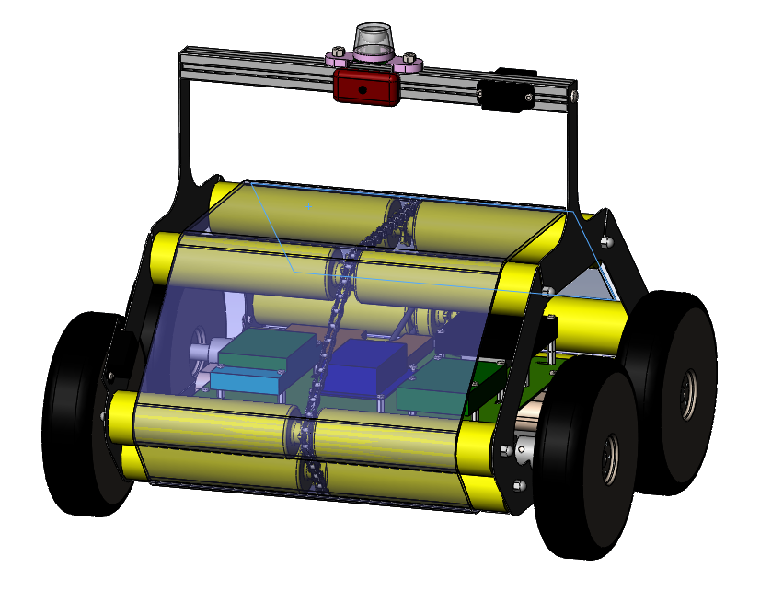
Conveyoring
Smooth belt
Chain
1 Motor
13
Introduction HW mechanics HW electronics Budget Software Management

Slide 14
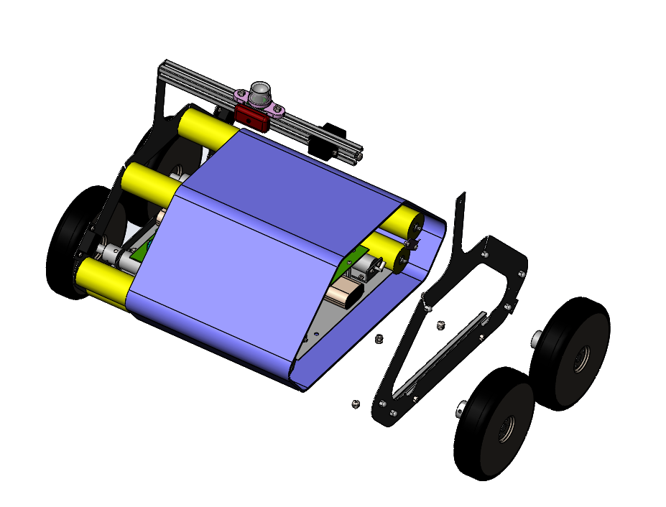
Assembly
Changing the conveyer belt
2 screws for wheels
11 screws for the plate
The sticky belt (already attached on the chain) is slided on the rollers
14
Introduction HW mechanics HW electronics Budget Software Management

Slide 15
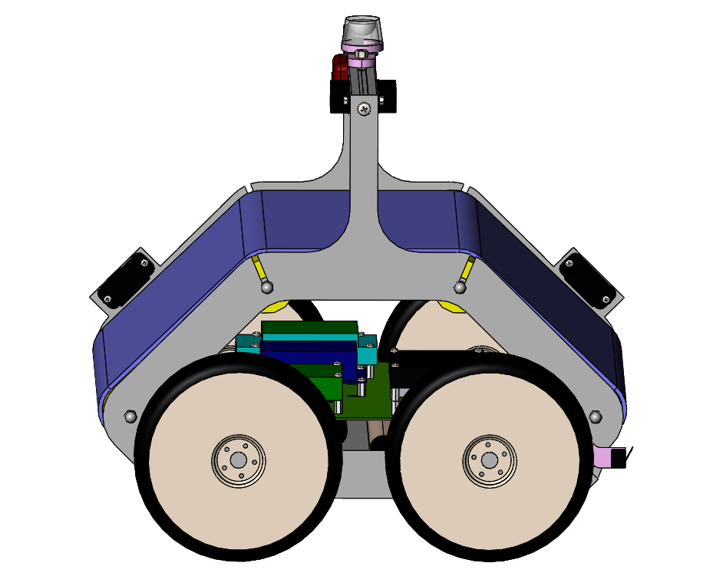
Adjustments
Tension in the sticky belt
Moving the axles of the rollers
Held with screws
15
Introduction HW mechanics HW electronics Budget Software Management

Slide 16
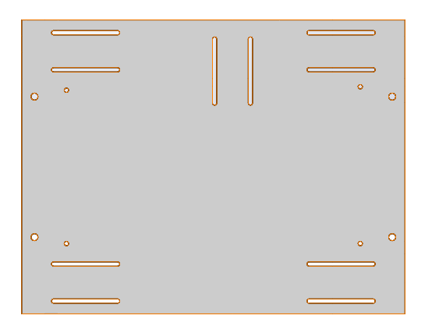
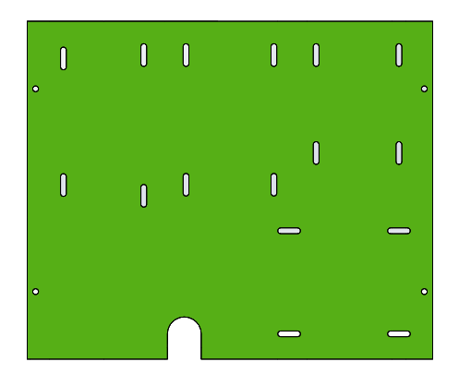
Adjustments
MOTOR PLATE
There are some unknown dimensions in components we haven’t ordered yet
We want to have the freedom of adjusting positionning of the motors
STRATEGY
Oblong holes
PCB PLATE
16
Introduction HW mechanics HW electronics Budget Software Management

Slide 17
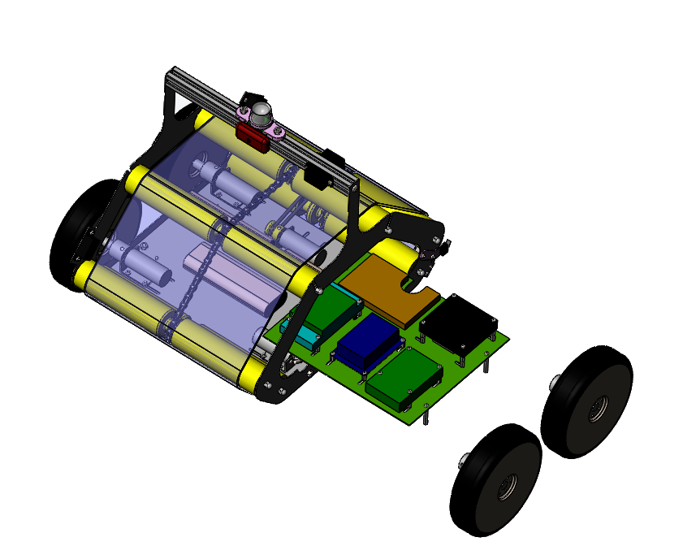
Assembly
Removing the electronic
2 screws for wheels
4 screws for the PCBs
The PCB has to be electrically disconnected from the parts which remain in the robot
17
Introduction HW mechanics HW electronics Budget Software Management

Slide 18
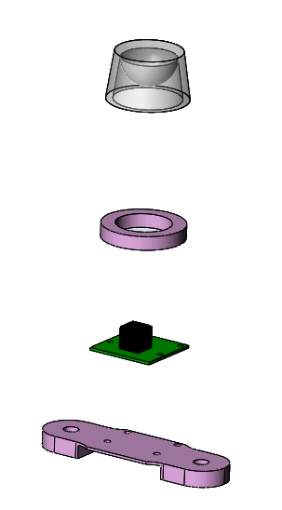

Mechanical components
360° mirror
3D printing
Raspberry camera
3D printing
18
Introduction HW mechanics HW electronics Budget Software Management

Slide 19
Mechanical components
list of mechanical components
what we make / buy and where
production process
backup
19
Introduction HW mechanics HW electronics Budget Software Management

Slide 20
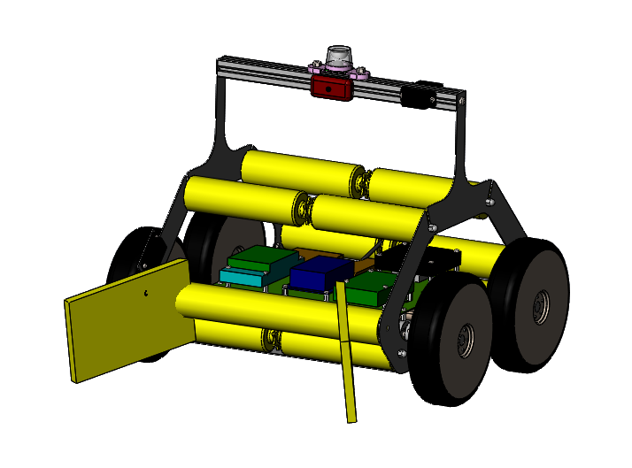
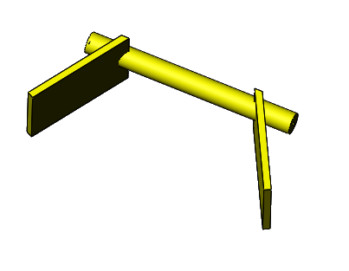
Backup plan
20
Introduction HW mechanics HW electronics Budget Software Management

Slide 21
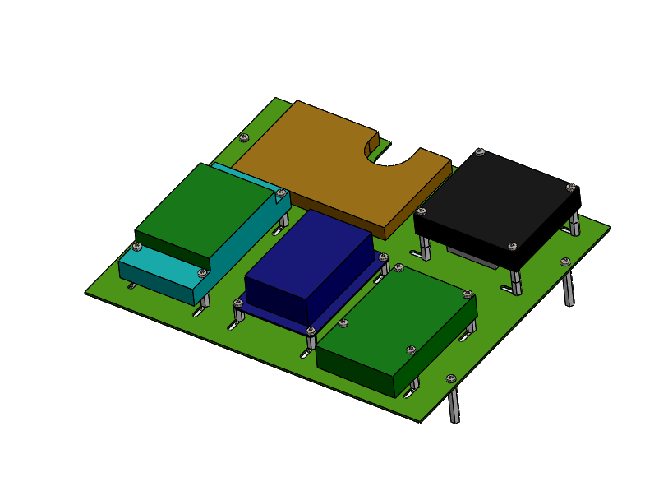
Electronic assembly
PCB components
DF Motor Driver
Raspberry Pi
Arduino and Arduone
Odroid
21
Introduction HW mechanics HW electronics Budget Software Management

Slide 22
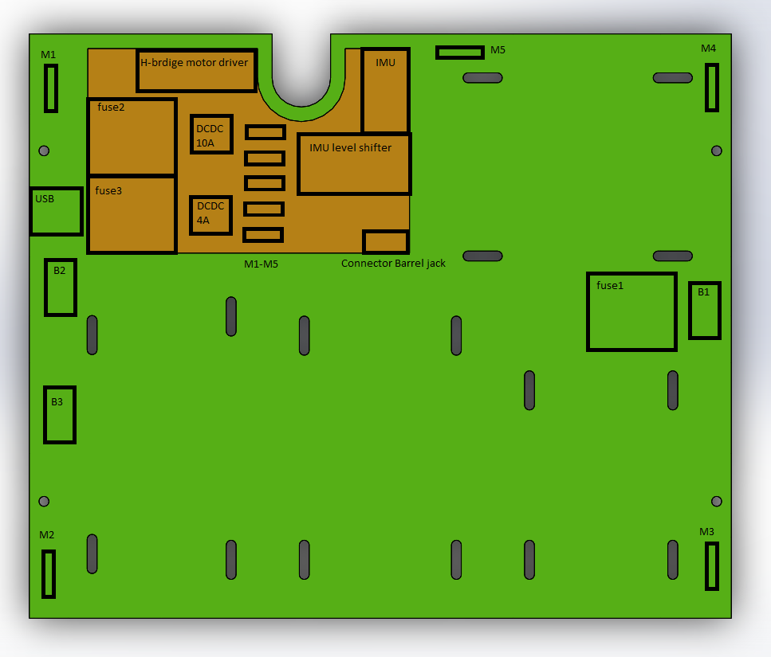
PCB plate
22
Introduction HW mechanics HW electronics Budget Software Management

Slide 23
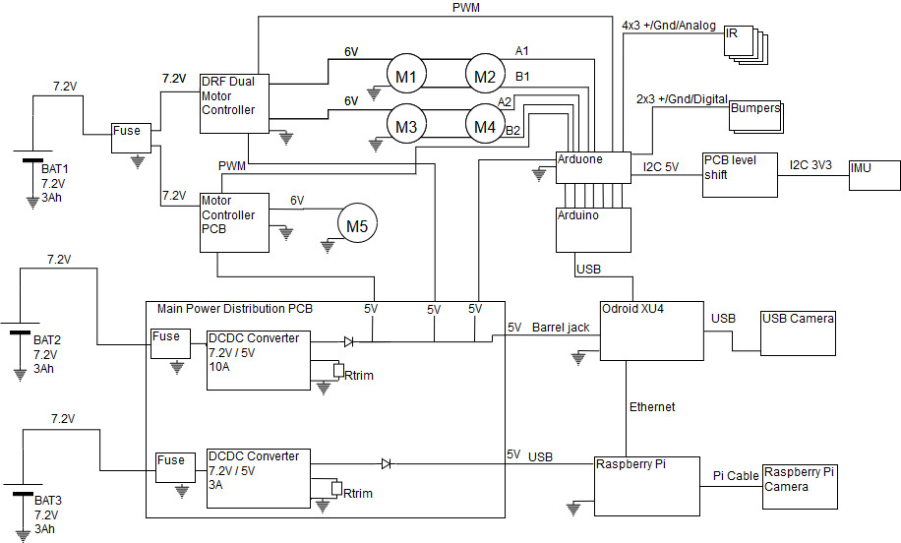
Electrical design
23
Introduction HW mechanics HW electronics Budget Software Management

Slide 24
Power budget
 | Part | Vcc [V] | Current [A] | Total consumption [W]
4 | Motors (Wheels) | 6 | 2.4 | 57.6
1 | Motor Conveyor | 6 | 2.4 | 14.4
1 | Raspberry Pi | 5 | 2.5 | 12.5
1 | Raspberry Camera | 5 | 0.25 | 1.25
1 | Odroid | 5 | 4 | 20
1 | USB camera | 5 | 0.15 | 0.75
1 | Arduino | 12 | 0.1 | 1.2
1 | Arduone | 12 | 0.1 | 0.6
10 | Sensors | 5 | 0.05 | 2.5
Margin 50% |  |  |  | 55.4
Total |  |  |  | 162.2
Runtime 20min at 6V |  |  | 9200mAh
24
Introduction HW mechanics HW electronics Budget Software Management

Slide 25
Electrical components
Obtained | On shopping list | Distributor | Arrival
Arduino + Arduone | Odroid (eMMC) | MakerShop | 28th of April
Raspberry Pi | USB Camera | MakerShop | 28th of April
Raspberry Camera | 2x Bumpers | RS Components | 28th of April
IMU | 2x DC converters | RS Components | 28th of April
IR sensors | H-bridge motor driver | EPFL | 6th of May
3x Battery | Cables and Connectors | EPFL / Conrad | 26th of April
5x Motor w/ encoders | Resistors, Capacitances and Regulators | RS Components | 28th of April
Dual H-bridge
25
Introduction HW mechanics HW electronics Budget Software Management

Slide 26
Budget management
 | Allocated |  | Used
 | Internal | External | Internal | External
Mechanical | 1000 | 400
Electrical | 700 | 450 | 550 | 0
Reserved | 300 | 150
Total | 2000 | 1000
Leftover
Used: 600.-
Reserved 1400.-
Leftover: 1000.-
26
Introduction HW mechanics HW electronics Budget Software Management

Slide 27
Budget management
 | Allocated |  | Used
 | Internal | External | Internal | External
Mechanical | 1000 | 400
Electrical | 700 | 450 | 550 | 0
Reserved | 300 | 150
Total | 2000 | 1000
Leftover
Used: 600.-
Reserved 1400.-
Leftover: 1000.-
27
Introduction HW mechanics HW electronics Budget Software Management

Slide 28
Communication schematics
Odroid
Command to move to point (x,y), low frequency
Communication:
ROS Jade
30 fps
B_{x}, B_{y},
Distance
Low frequency
USB
Cam
RPI
2
Commands
Bool: stock
Ardu-ino
High frequency signals
30 fps
Pmw, high f
RPI
Cam
Motor Driver 1
Motor Driver 2
IMU
IR
4x
Encoder
Bumpers
M1
M1
M1
M1
M1
28
Introduction HW mechanics HW electronics Budget Software Management
general architecture of the program
Claudio will do!

Slide 29
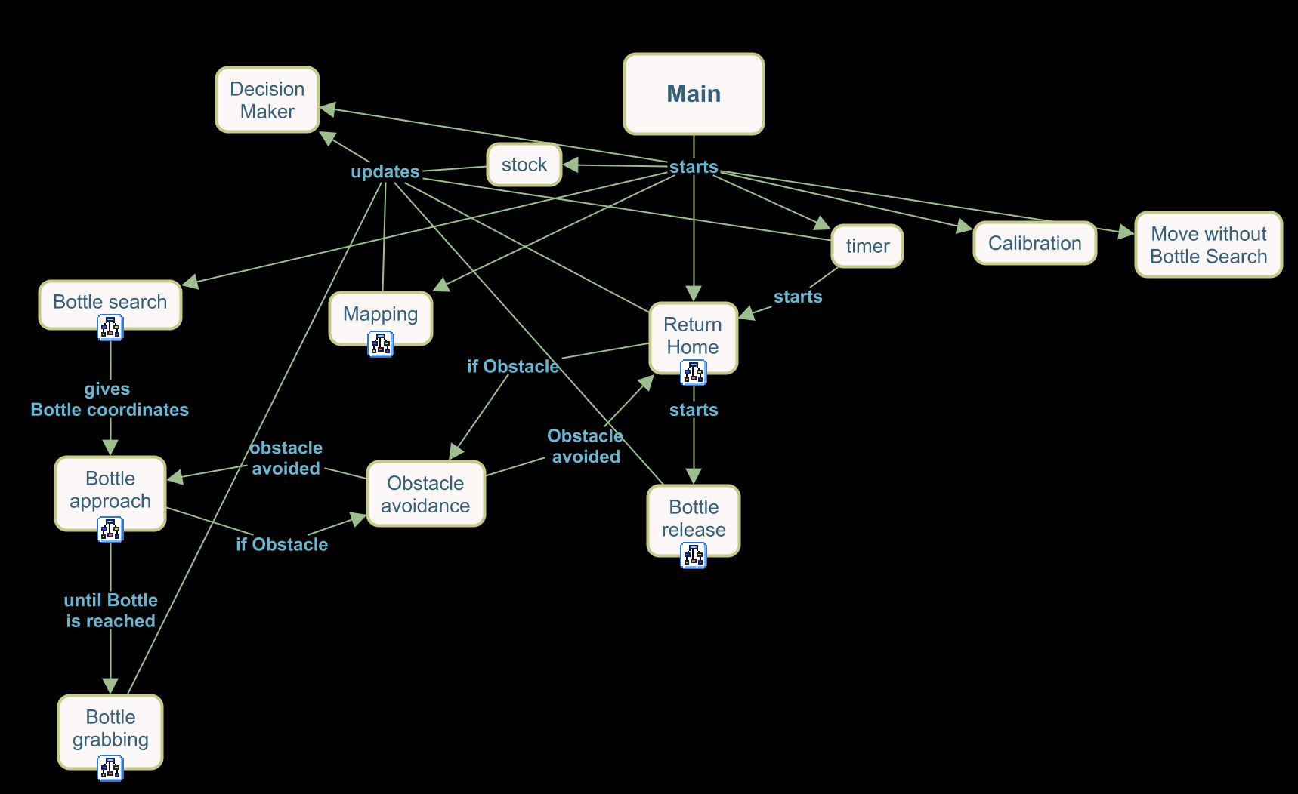
Software architecture
29
Introduction HW mechanics HW electronics Budget Software Management
general architecture of the program
Claudio will do!

Slide 30
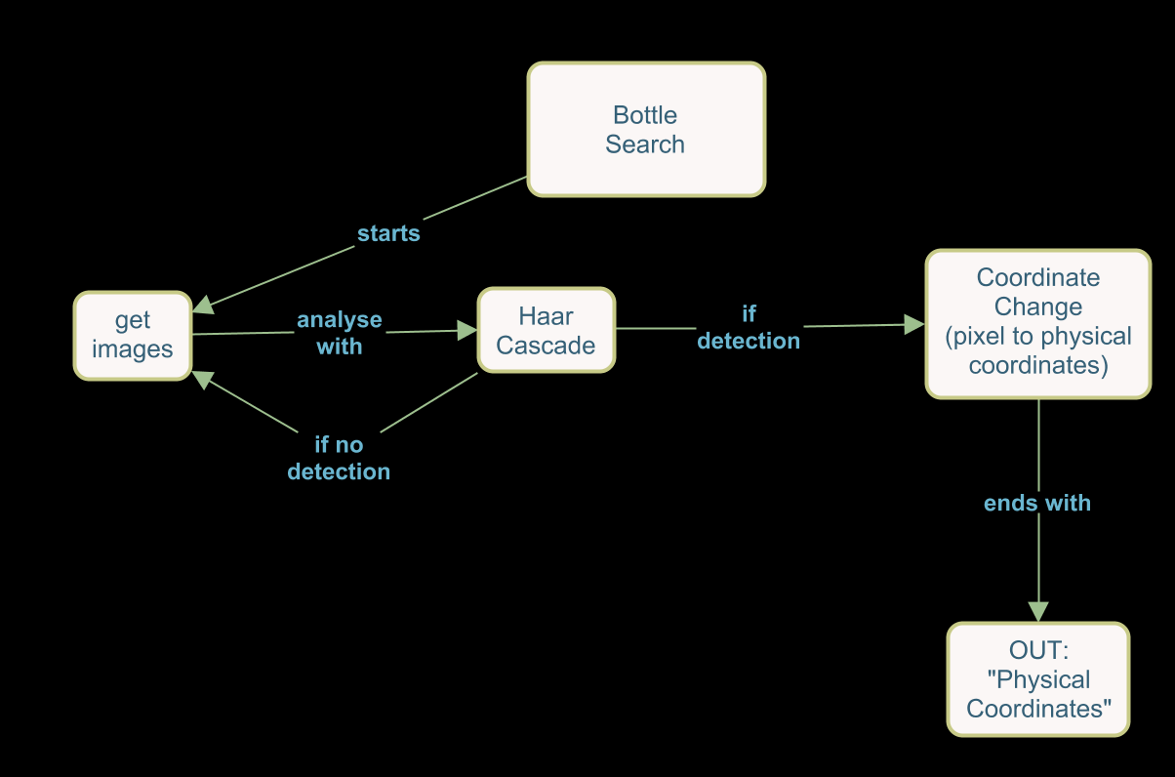
Bottle detection
Results
30
Introduction HW mechanics HW electronics Budget Software Management

Slide 31
Obstacle avoidance
Results
31
Introduction HW mechanics HW electronics Budget Software Management

Slide 32
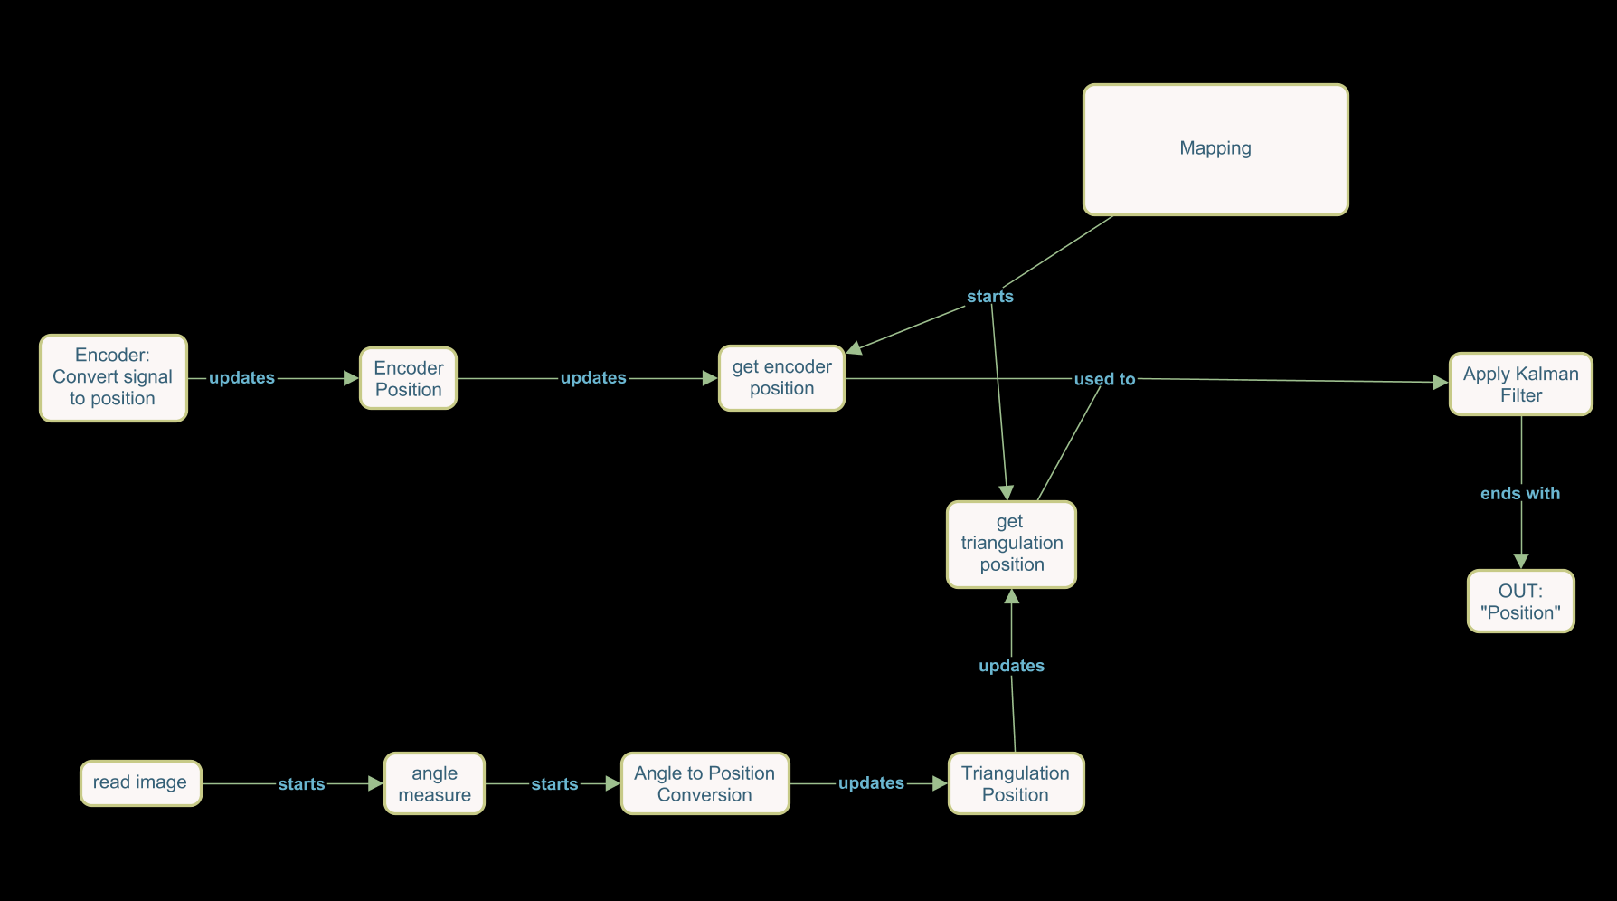
Localization
stratégie de ou on va d'abord, etc
pseudo-code
Backup plan!
32
Introduction HW mechanics HW electronics Budget Software Management

Slide 33
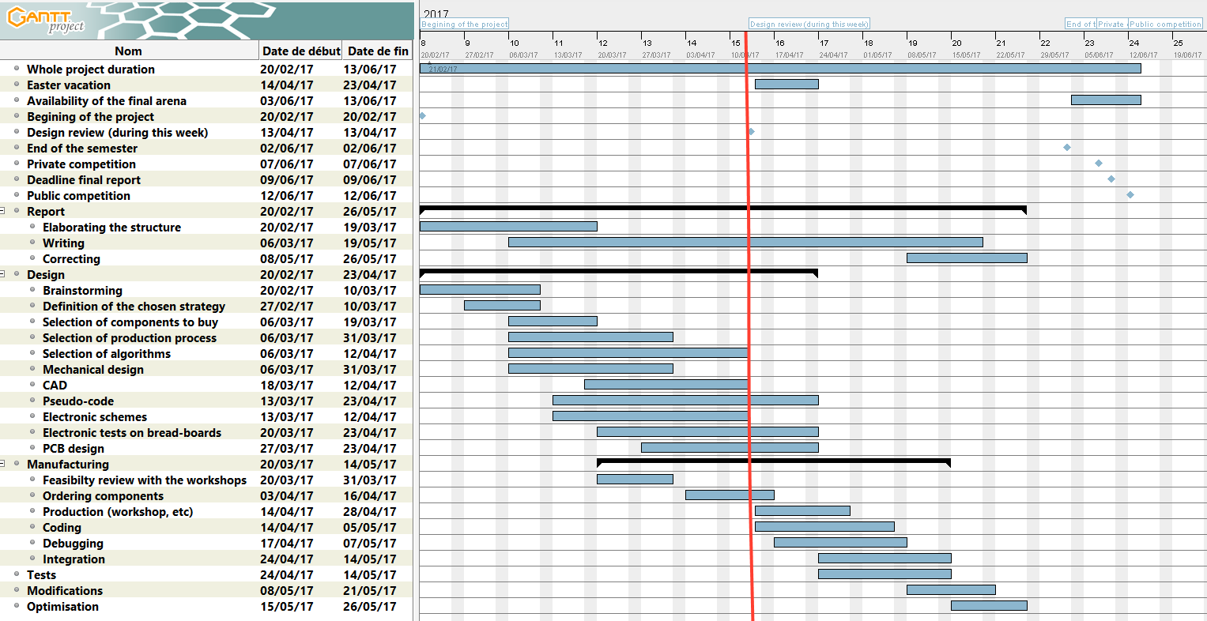
Time management
33
Introduction HW mechanics HW electronics Budget Software Management

Slide 34
Tasks management
ACHIEVED TASKS
CURRENT DISTRIBUTION
FUTURE TASKS
Mechanical Design
Electronical Design
Software architecture
Corrections of the mechanical design
Production of mechanical parts
Ordering of mechanical parts
Prototype of the electrical design
PCB production
Ordering of electrical parts
Computer Vision
Coding
Report Writing
Building the robot
Tests
Optimisation
34
Introduction HW mechanics HW electronics Budget Software Management

Slide 35
Thank you for your attention
Notes:
Questions?

